Slide 1
IoT-Based
Transportation System for Accident Prevention and Detection
Mukesh N
Sri Ram Prasanth D Thirusakthi S
Hari Haran S
Department of Information Technology
Bannari Amman Institute of Technology

Slide 2
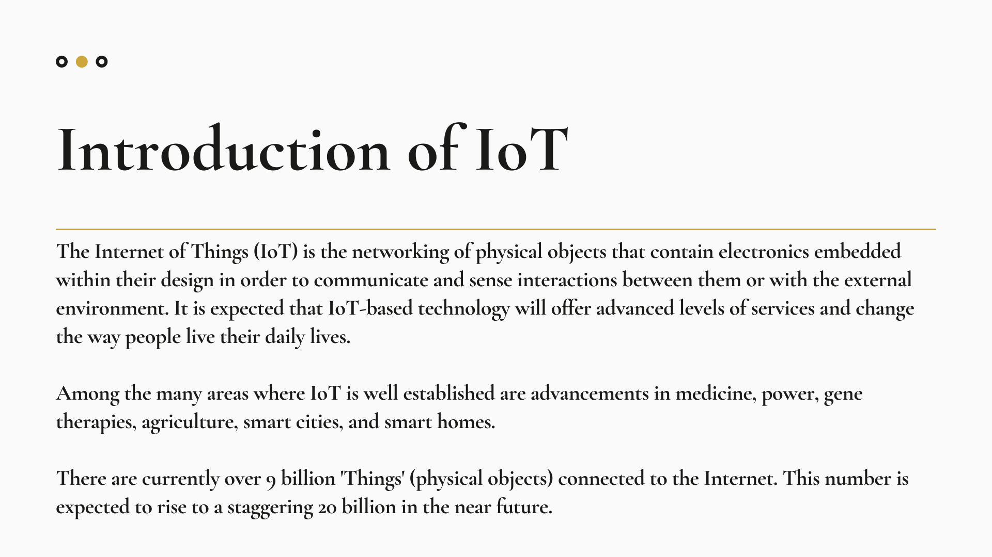

Slide 3
Introduction
India is a developing nation, with advanced transportation technology and an increase in the number of vehicles. As a result, traffic hazards have increased. The number of road accidents occurring regularly is on the rise, resulting in a large number of deaths due to poor emergency facilities
WHO says that 1.25 million people die each year due to road accidents. A road accident kills someone in India every four minutes. Road accidents increased by 2.5 percent from 4,89,400 in 2014 to 5,01,423 in 2015. It has been concluded that carelessness and fault of the driver are the main causes of road accidents, deaths, and injuries on all roads in the country.

Slide 4
Abstract
In this paper, an intelligent system is proposed for the detection and prevention of two-wheeler accidents. As part of the prevention, the helmet detects whether a driver is wearing a helmet and has non-alcoholic breath while driving.
If these conditions are met, the relay will activate. Microcontrollers control the relay and therefore the ignition.
As part of the system, accidents can also be detected at any place and reports can be sent to predefined numbers with the GSM module. All the parameters of the automobile are continuously recorded by the Microcontroller to prevent and detect accidents

Slide 5
Disadvantages of Existing System
The Injured People treatment can be delayed.
Can Affect the Traffic of the road.
Drunken Drivers will affect Normal Drivers
Advantages of the Proposed System
The Emergency contact will be called immediately.
The User will be informed if there is an accident nearby.
The alcohol sensor will detect any alcoholic reading.
Cost-effective.

Slide 6
Switch
RF
Transmitter
RF
Transmitter
LCD
Smart
Phone
Buzzer
Alcohol
Sensor
Arduino
Proposed System
Relay
Motor
The relay will turn on the motor of the two-wheeler only when the helmet is worn and non-alcoholic breath is detected. The microcontroller will continuously monitor the alcohol level in the rider’s breath using an alcohol sensor. If the accident is detected using accelerometer sensors, information will be sent to the registered number using smartphone.
Accelerometer
sensor
Bluetooth Module

Slide 7

Alcohol Sensor
MQ-3 gas sensors can detect alcohol content in the breath. It has high sensitivity and a fast response time. Thus, the sensor can be placed just below the face shield and above the face protection. It detects the alcohol from the rider’s breath; the resistance value drops leading to a change in voltage. The microcontroller receives the data from the sensor, the inbuilt analog to digital converter in the Arduino will convert the analog output to corresponding digital data. The converted digital value can be viewed using an LCD display.
Helmet Detection
The section contains a switch, an RF transmitter, a receiver module, an encoder, and a decoder. The switch detects whether the rider is wearing a helmet or not. When the rider wears the helmet, the switch inside will be closed. Or it will remain open. The digital output of the switch will be sent to the encoder. It encodes the given input into a coded binary output. The encoded output is given to the RF transmitter.RF transmitter receives serial data and transmits it wirelessly through RF through its antenna. The coded binary data received by the RF receiver will be sent to a decoder. . The decoder decodes the input and sends it to Arduino.

Slide 8
Relay
A relay is a device that can be made to switch on or off a much larger electric current with the help of a comparatively small amount of current. The heart of a relay is an electromagnet. The relays can be used either as a switch (to turn devices on and off) or as an amplifier (to convert a small amount of current into a larger amount). In this paper, the relay plays a major role, as it is used to turn on the engine based on two conditions. The relay is programmed to be turned on only when the rider wear helmet and no alcohol is detected in his breath. If any one of these two conditions fails, the engine cannot be turned on.
Accident Detection
The accident is detected by the fall of the vehicle, using an accelerometer sensor. An accelerometer measures the acceleration forces in which it is fitted. Such forces may be static, like the continuous gravitational force, or as in the case with many mobile devices, dynamic to sense movement or vibrations. Acceleration is the measurement of the change in velocity or speed divided by time.

Slide 9
The accelerometer is connected to the microcontroller. If there are any sudden changes occur in the position of the vehicle it is detected as an accident. If an accident is detected, then the information is sent to the android mobile using a Bluetooth module. The sensor with Bluetooth module will trigger emergency and transmit the data over Bluetooth communication whereas the smartphone which is paired & in the range of the sensor is working as receiver of this information and is responsible for recording and processing further. The Smartphone will send the message along with other information like current location tracked by GPS on the phone, mobile number, and incident time to a registered number via TCP/IP.
Bluetooth Module
Bluetooth is a wireless technology standard for transmitting and receiving data over short distances from fixed and mobile devices. It simplifies the discovery and setup of services between devices. It contains a tiny computer chip and software that makes it easy to connect. Once the accelerometer detects the accident, the data is sent from Bluetooth to the smartphone.

Slide 10
Microcontroller
In this paper, the Arduino ATMEGA-328 microcontroller is used.Arduino is an open-source microcontroller. The Arduino boards are programmed through RS232 serial interface connections with ATMEGA328p Arduino microcontroller.The input voltage recommended for the Arduino microcontroller is from 7v and the maximum of 12v

Slide 11
Conclusion
This system consists of two parts, accident prevention, and accident detection. The prevention part consists of helmet detection and alcohol detection.
This system is predicted to make significantly prevent accident and detects an accident.

